Slide 1
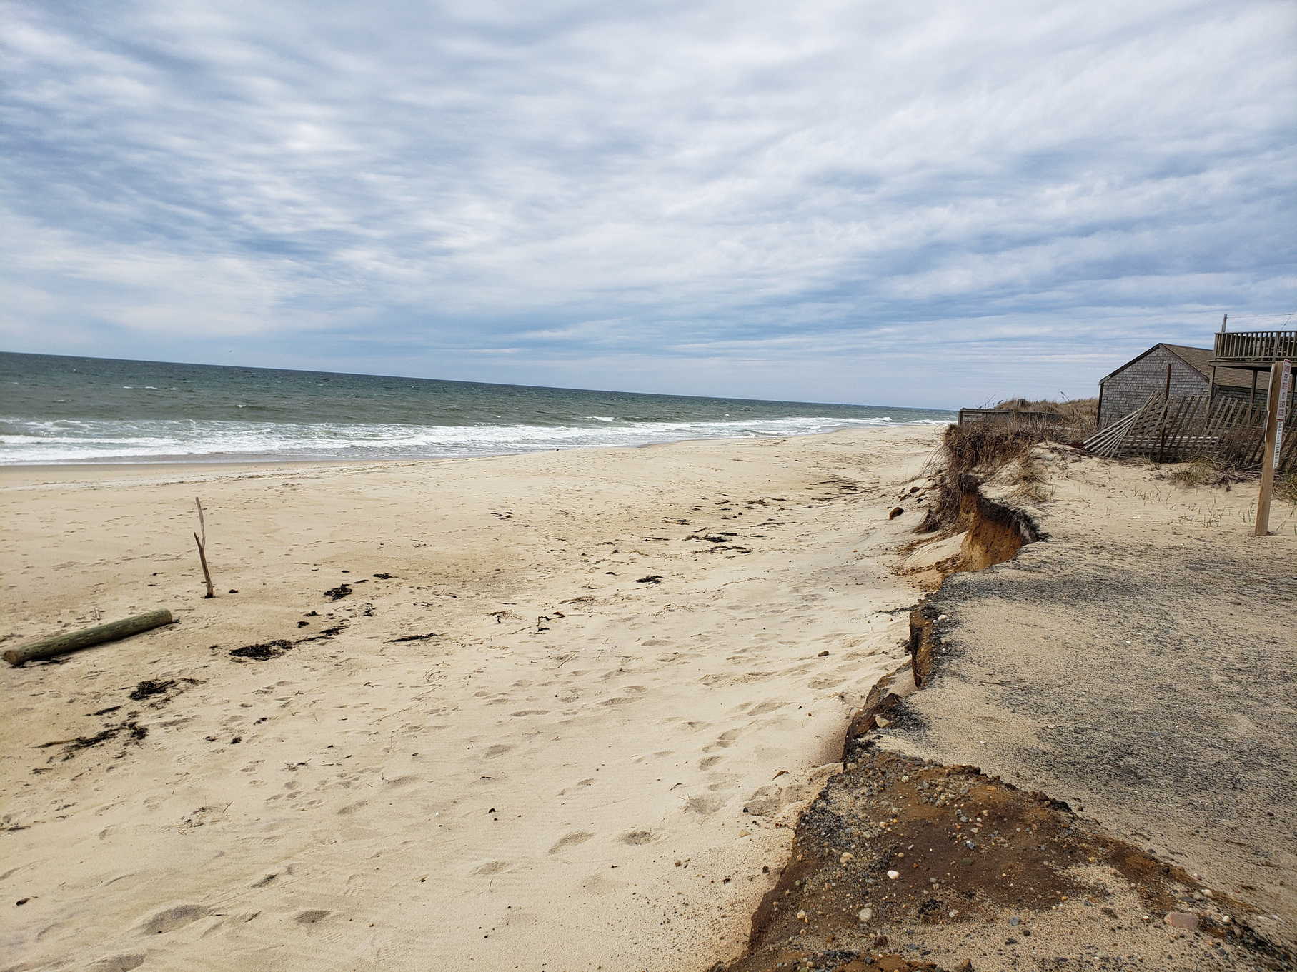



Farming through the Flood: Building Resilience for your Land and Livelihood
Shelly McComb
Coastal Resilience Specialist
Cape Cod Cooperative Extension
and Woods Hole Oceanographic Institution Sea Grant

Slide 2
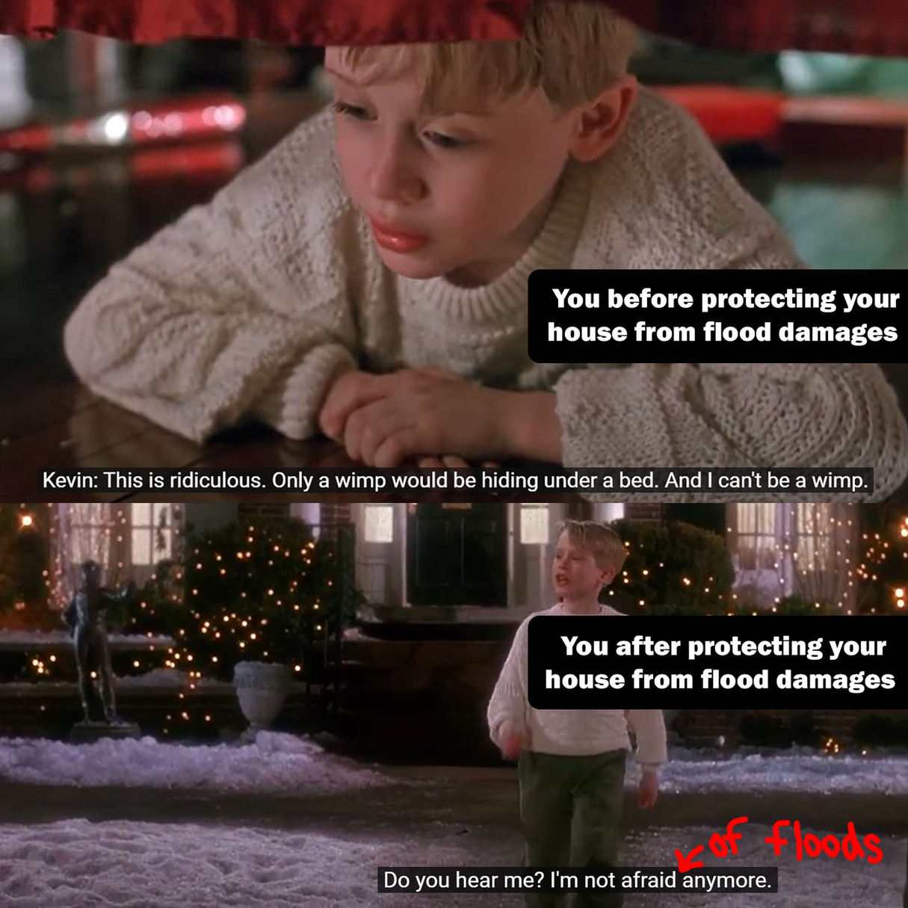
Comic relief provided by Portland District, U.S. Army Corps of Engineers
Common Myths
    “I survived Hurricane Bob and the nor’easters of 2018 and 2023, so I am sufficiently prepared.”
    “We had a 100-year storm recently so we won’t see another storm that big again for another 100 years.”
    “Strengthening my house is too expensive and not worth the effort.”
    “My house has never flooded in the 40 years I’ve lived here, so it never will.”
Notes:
Page 6-7

Slide 3
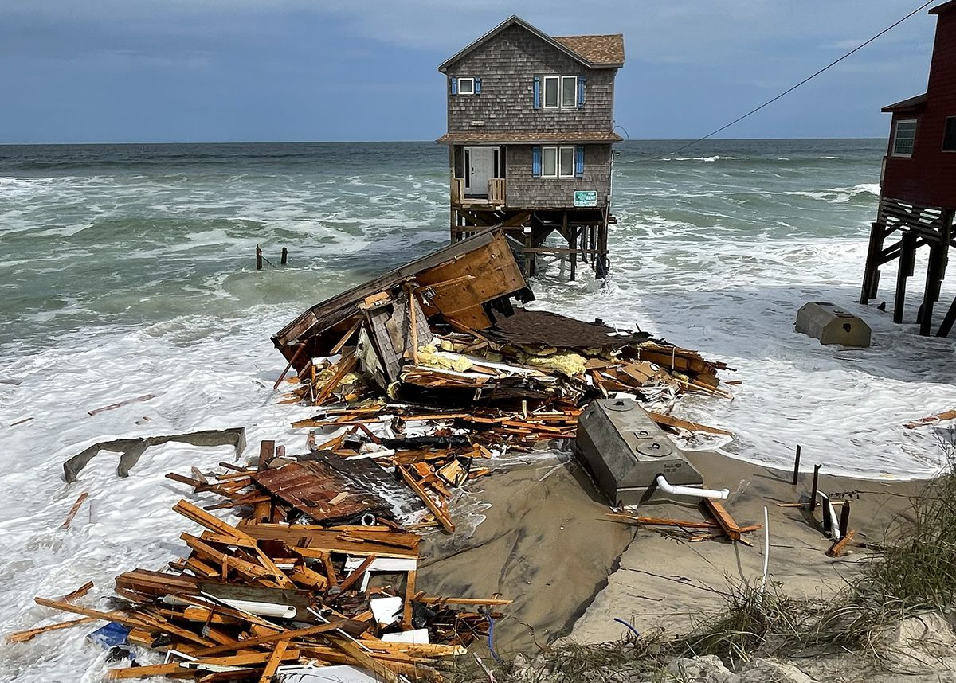
BACKGROUND
    Storms are increasing in frequency and intensity
      Warmer air holds more moisture, increasing the potential for strong storms overall and further north
    Rising sea levels will make storm surge more damaging
Debris associated with the collapsed house at 23039 G A Kohler Court is strewn along the beach Wednesday at Rodanthe. Photo: National Park Service
Read more at Coastal Review, coastalreview.org.

Slide 4
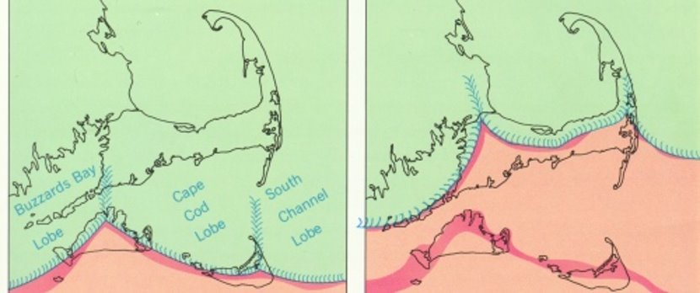

THE LAST ICE AGE
Laurentide Ice Sheet
  Up to 2 miles thick!
Glacial Maximum
  ~23,000 years ago
  (Pleistocene)
Retreat through Cape Cod
  ~18,000 years ago

Slide 5
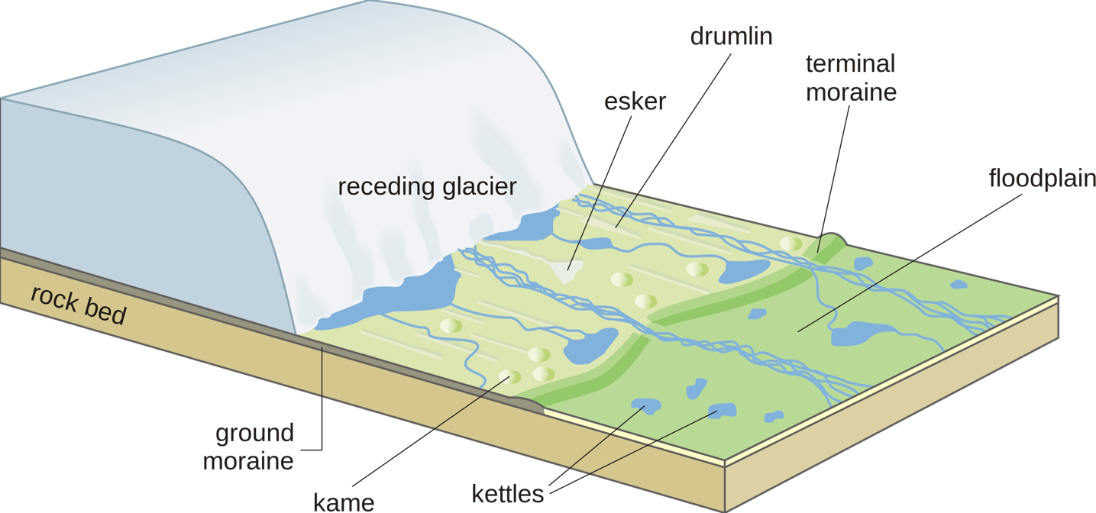
OTHER GEOLOGIC FEATURES
https://en.wikipedia.org/wiki/Glacial_landform#/media/File:Receding_glacier-en.svg

Slide 6
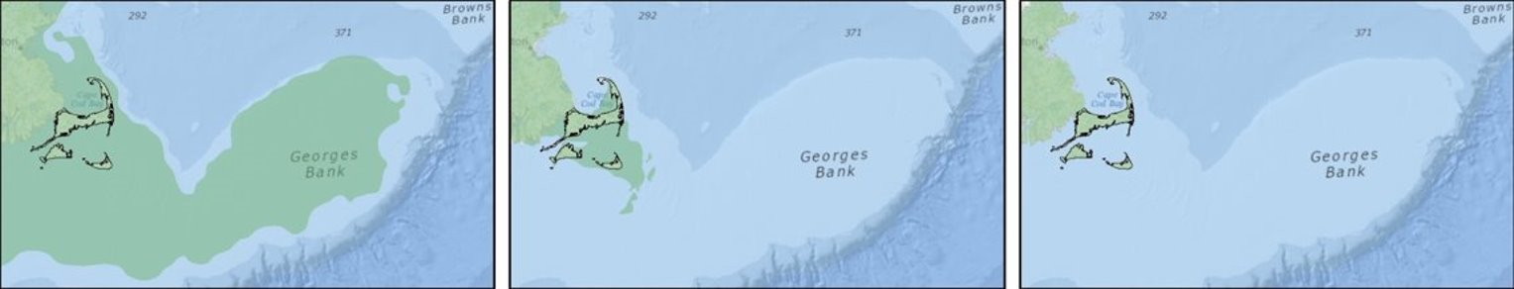
Sea level rise
11,000 years ago
6,000 years ago
Present day

Slide 7
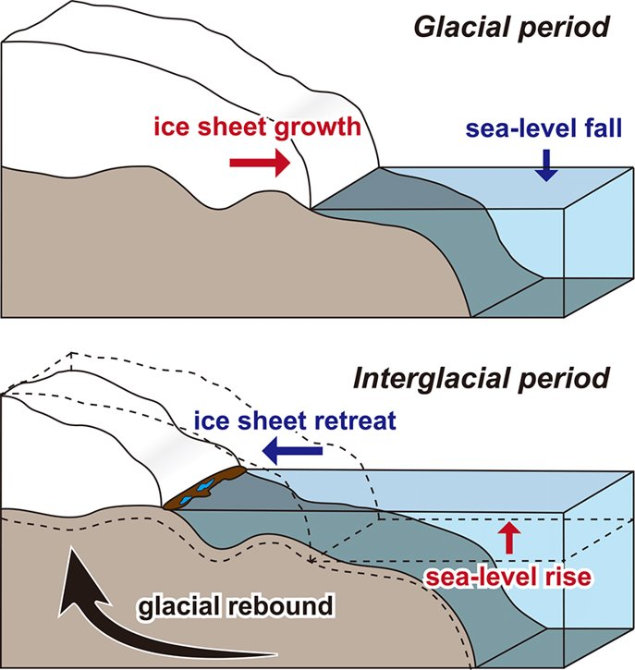
Isostatic Rebound
Ice sheets weight down the crust
As they melt, the crust returns, raising the land level
Suganuma et al., 2020

Slide 8
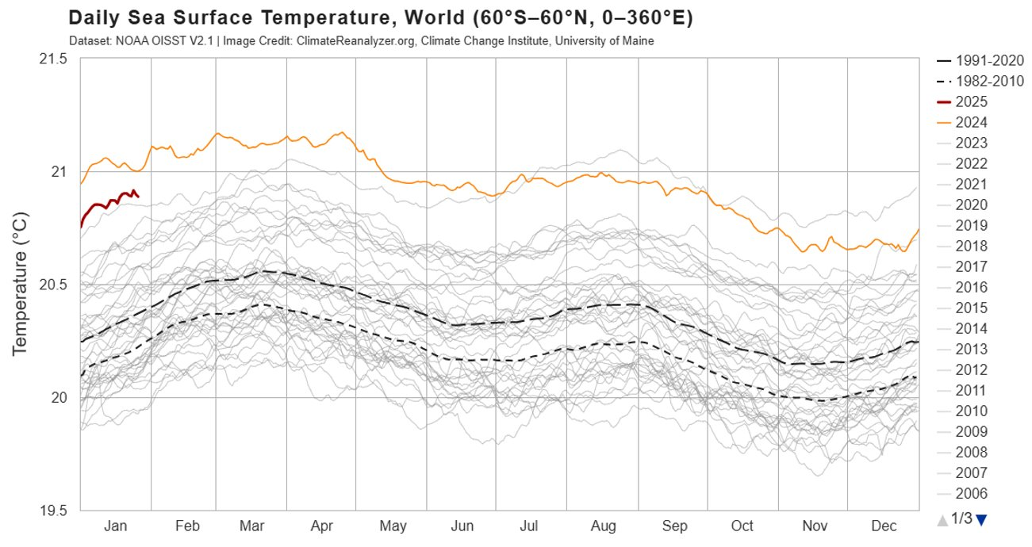
Thermal Expansion

Slide 9
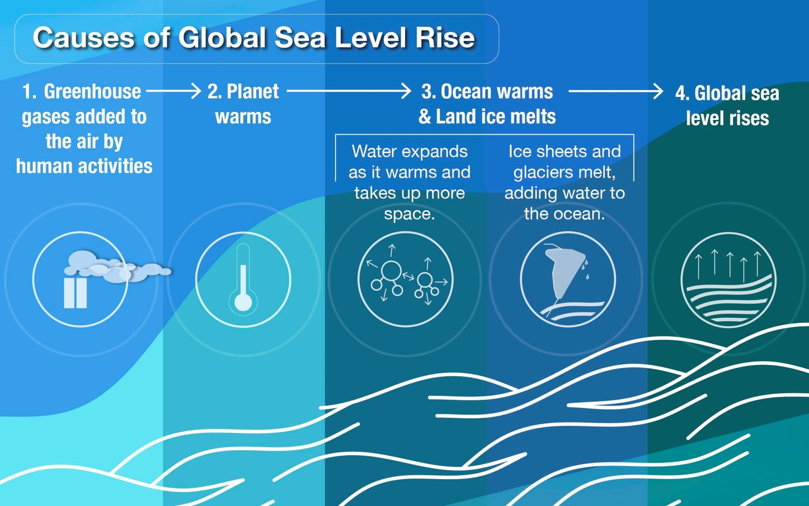
https://sealevel.globalchange.gov/sea-level-101/global-sea-level-rise/the-basics/

Slide 10
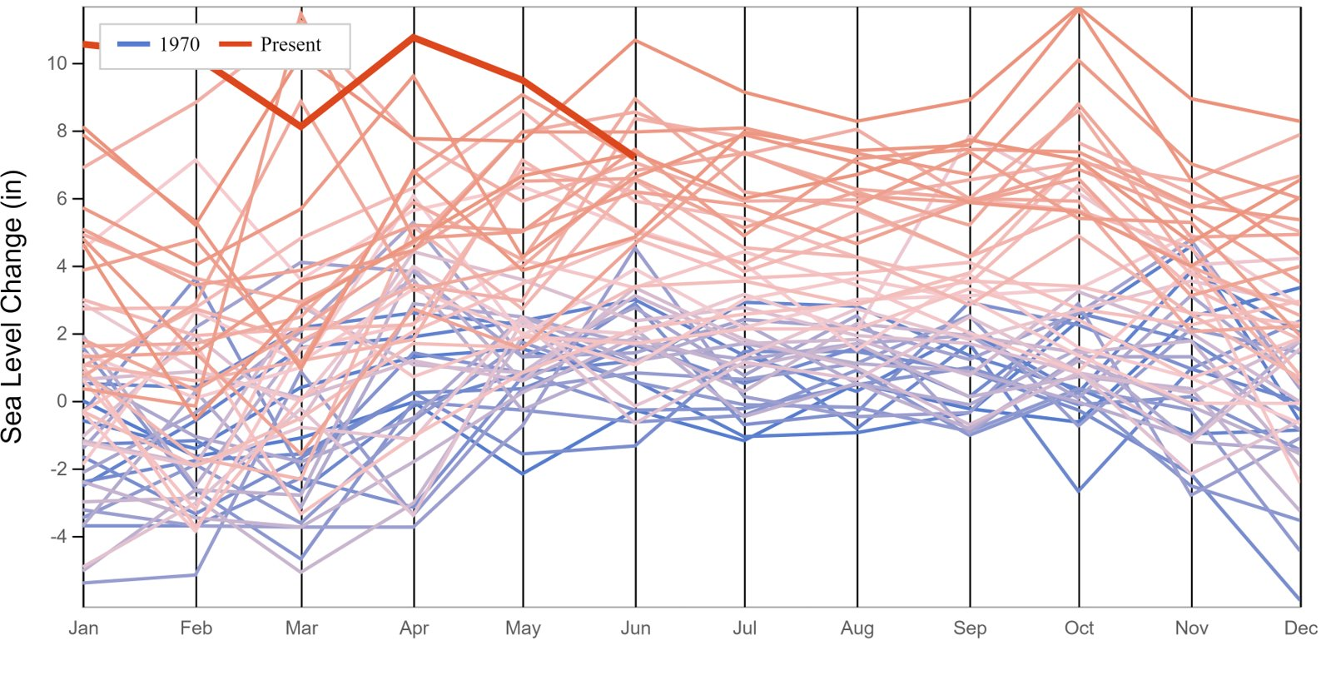
Sea level rise in Boston
https://sealevel.globalchange.gov/national-sea-level-explorer/?psmsl_id=235&scope=section_1

Slide 11
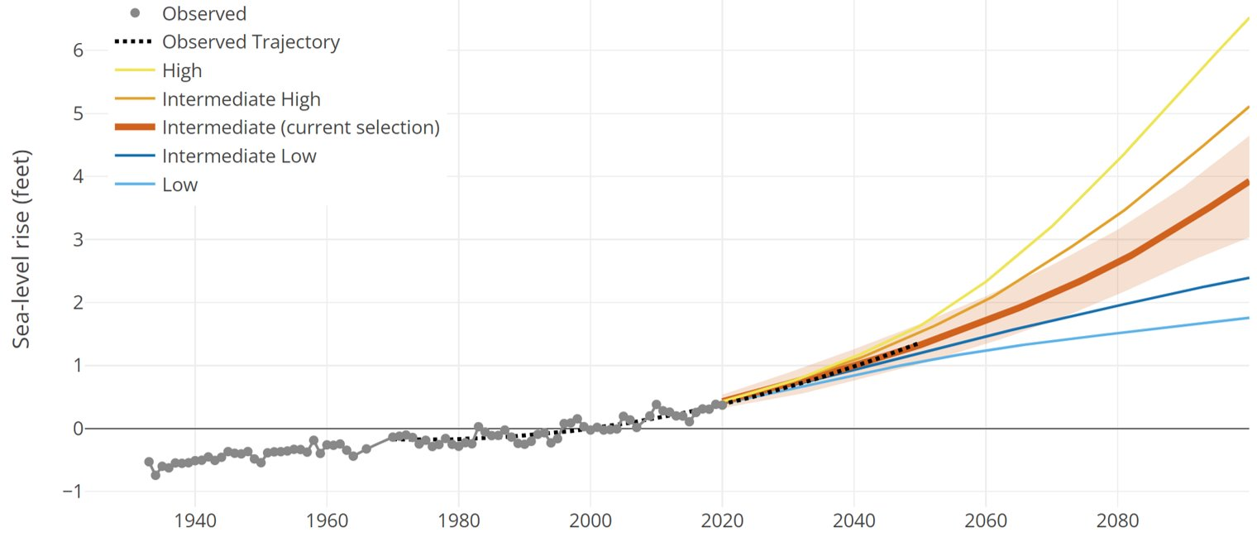
Projected sea level rise (Woods Hole)

Slide 12
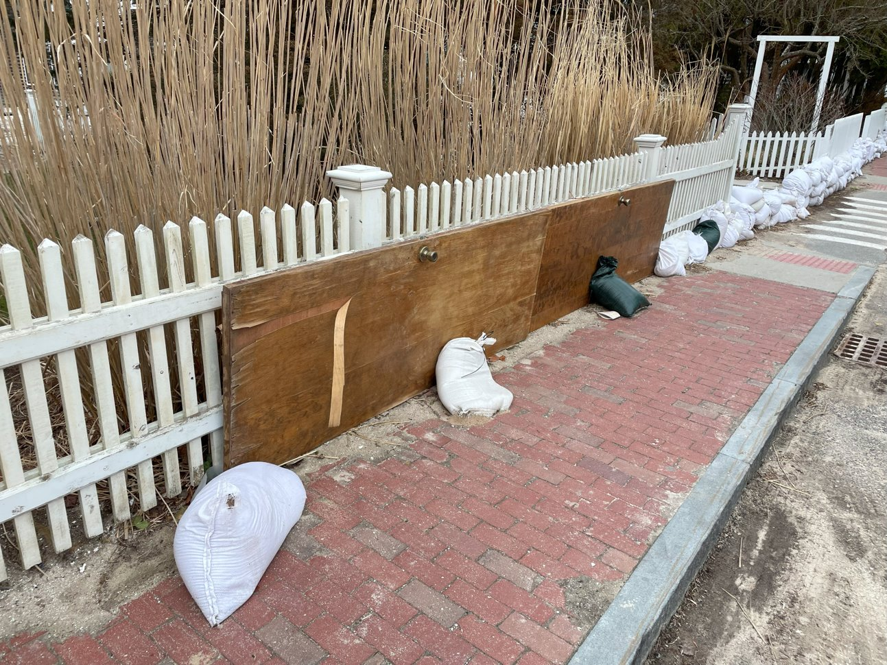

Slide 13

Sea surface temperatures drives hurricanes…
MORE HEAT
=
MORE FUEL
Photo credit: NASA

Slide 14
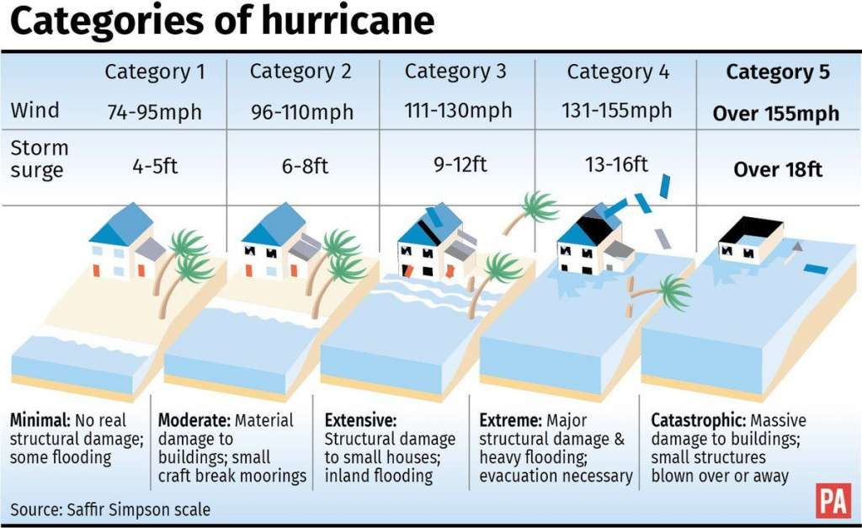
Saffir-Simpson Scale
Notes:
Why don’t we have a Category 5?

Slide 15
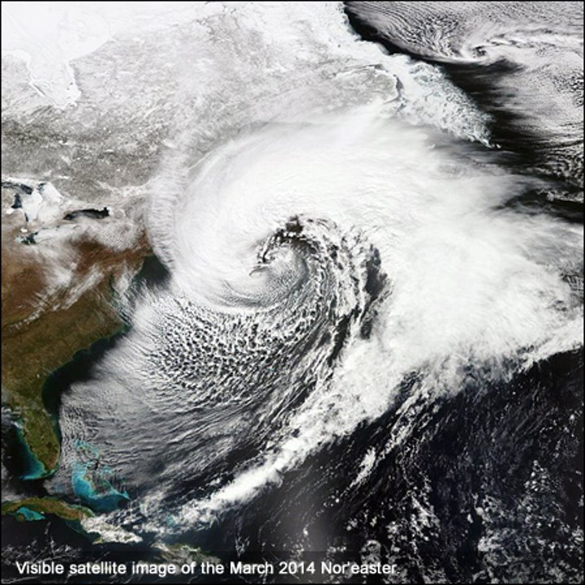
Nor’easters face the same heat
Photo credit: NOAA

Slide 16
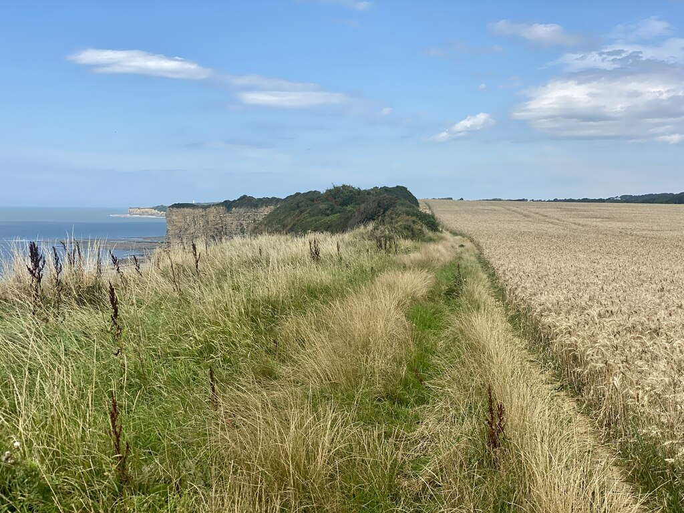
So…what does this mean for me?
    Increasing salinity levels could reduce crop yields
    Stronger storms and longer droughts (more extremes)
    Erosion of key nutrients
      Nutrient ponding from runoff
This Photo by Unknown Author is licensed under CC BY-SA

Slide 17
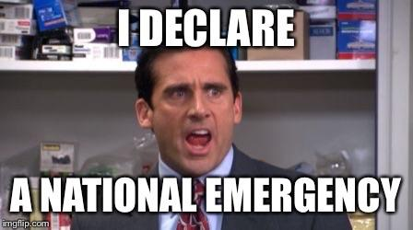

Slide 18

Flood Resilient Farming
    Stay and face losses
    Stay and adapt
    Relocate to safer areas
This Photo by Unknown Author is licensed under CC BY-NC-ND

Slide 19
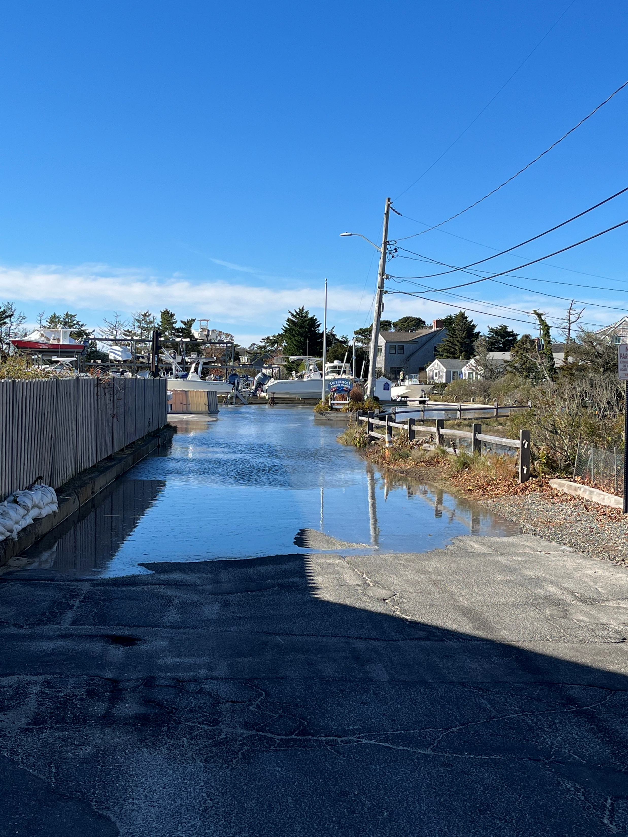
Flood Resilient Farming
    Stormwater management
      Berms and drains to redirect water flow
      Water gates, sand bags, or socks
    Water collection like rain barrels for drier seasons
    Diversifying and rotating crops for adaptability
    Reinforce infrastructure

Slide 20

Flood Resilient Farming
    Improve soil health
      Add organic matter for water retention
    Erosion control
      Contour planting across slopes
      Add a vegetative buffer around fields and along waterways
    Research weather-resistant crop varieties
    Create an emergency plan with other growers
      Document your property
      Store emergency supplies

Slide 21
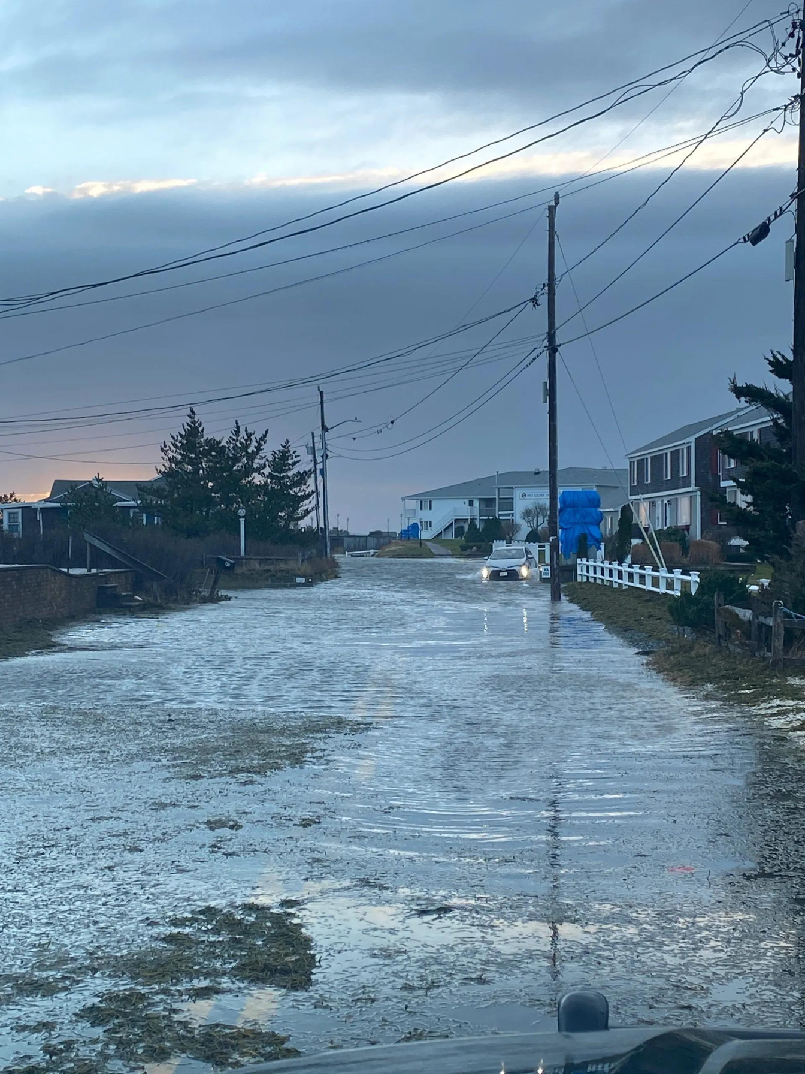
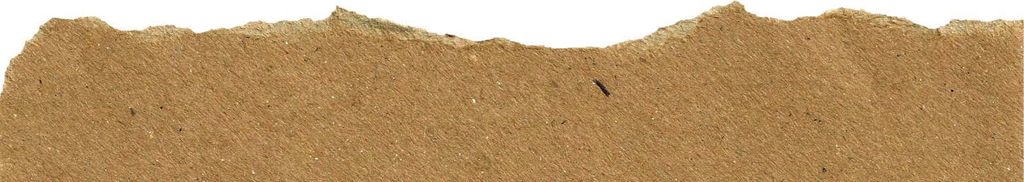
Best Practices for Soil and Crop Recovery
    Crop insurance
    Clean-up after a flood and monitor
      Lidar and other GIS technology to restore land to former leveling
    Leave crop resides and living mulches on the ground after a harvest

Slide 22
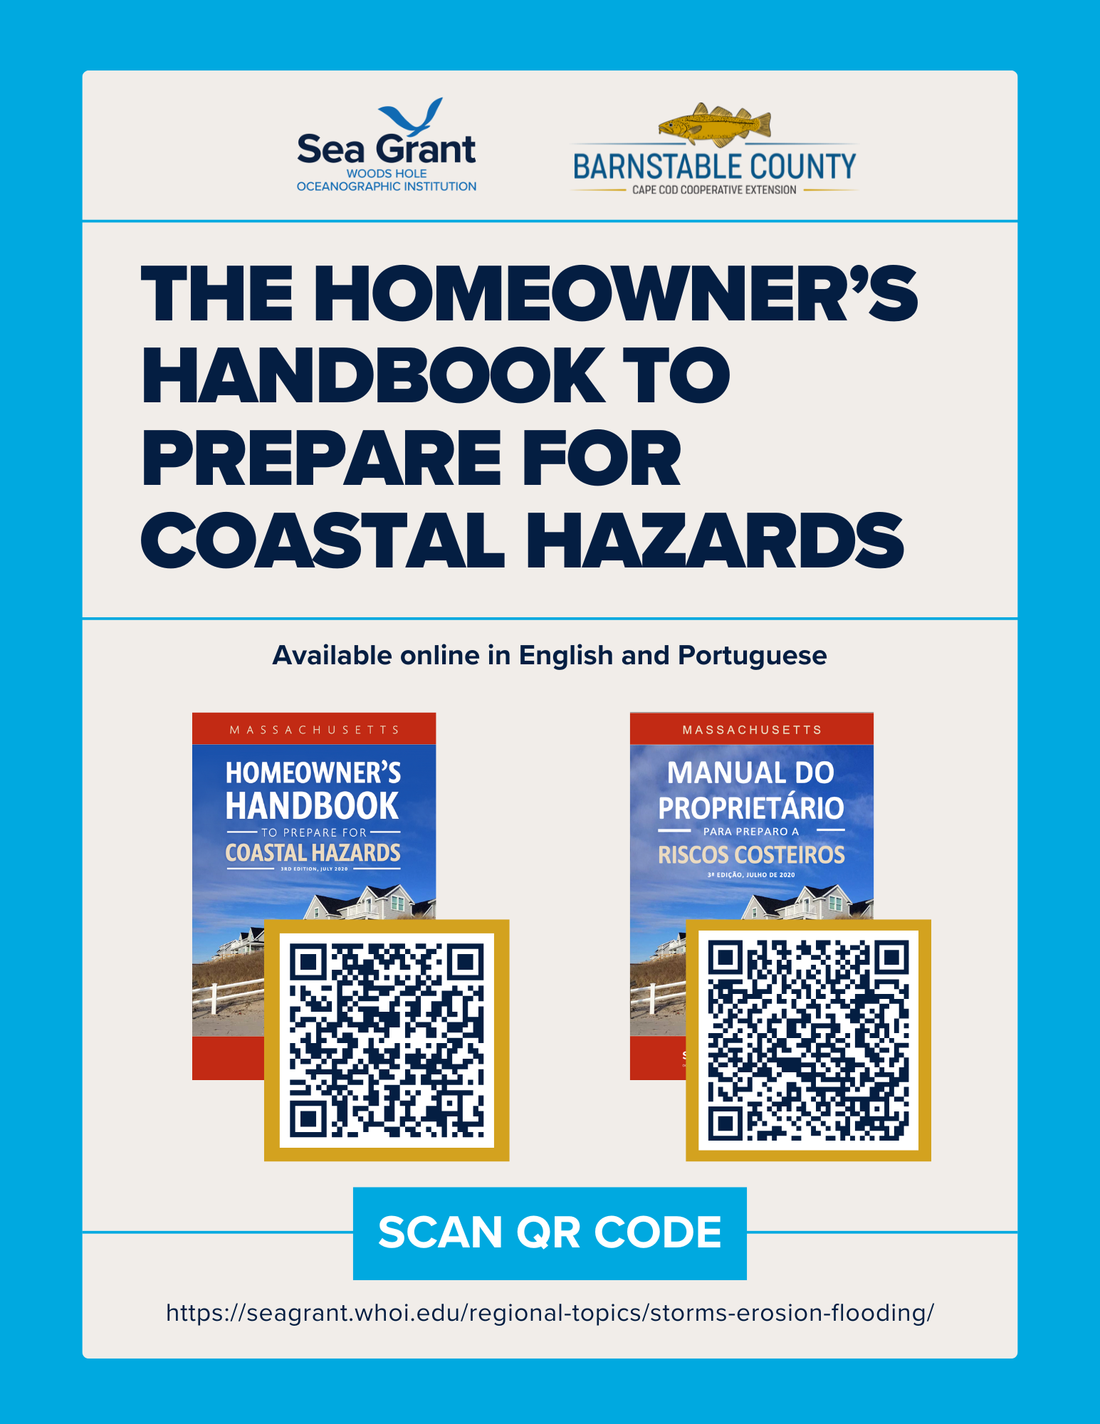

Slide 23
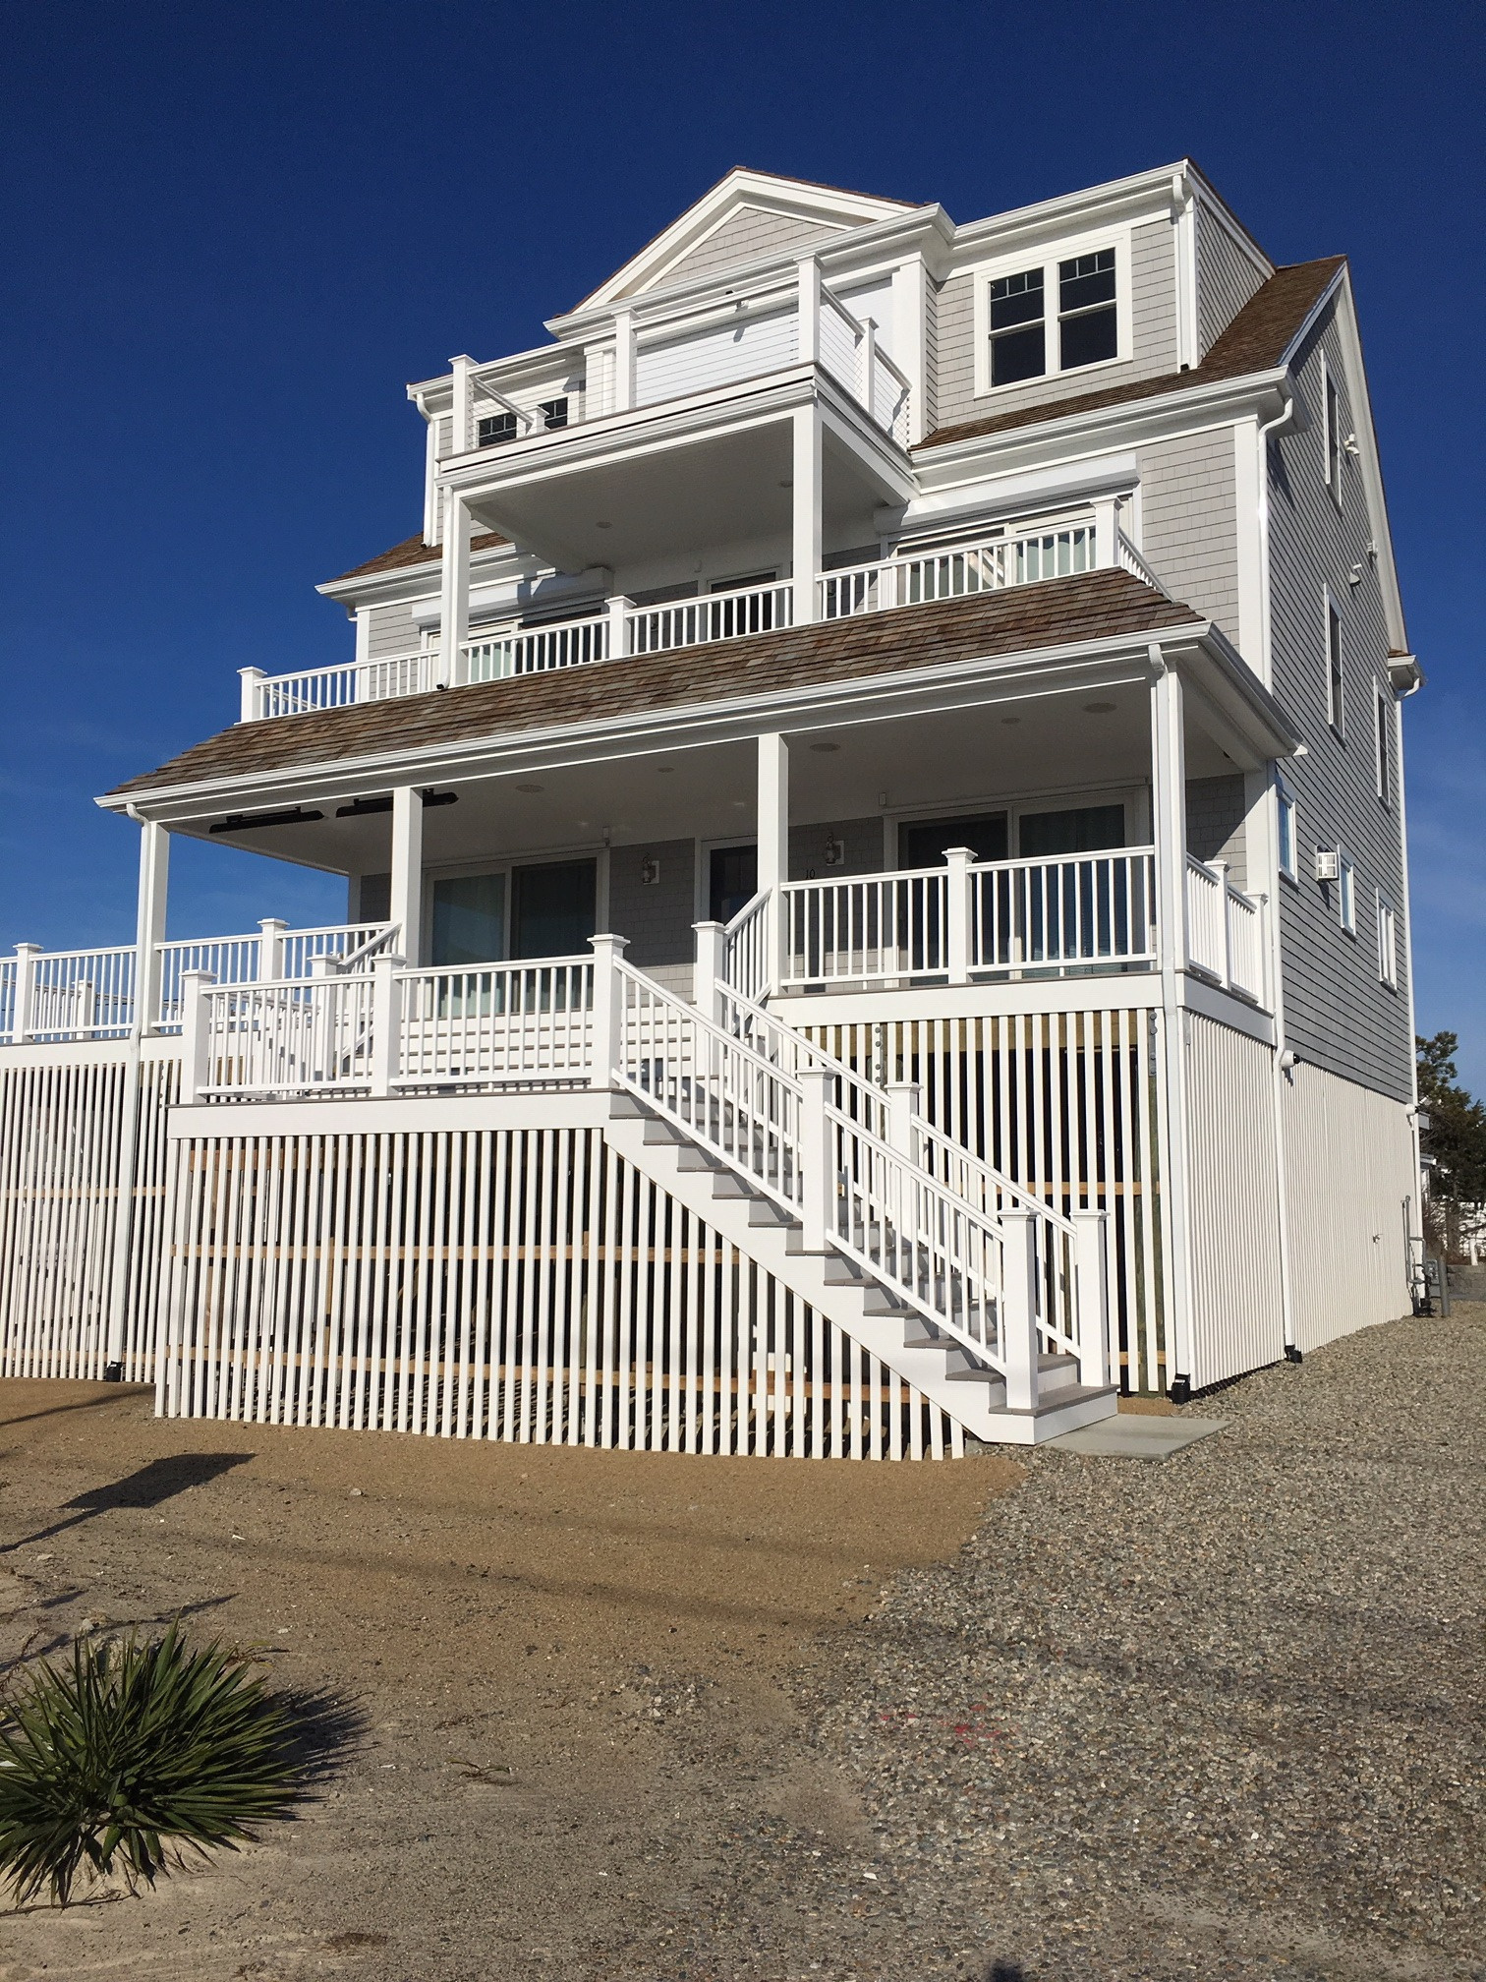
BEFORE
Secure your home in advance of a storm
    Elevate utilities
    If elevating the structure, increase freeboard
    Strengthen your roof and wall-to-foundation connections
    Install alternate sources of backup electricity (above flood levels)
    Install non-elevation flood retrofit measures
    Wet-floodproofing versus dry-floodproofing
    Assess potential damage from trees
Notes:
Freeboard- additional amount of height above base flood elevation
lifting things off the floor when you know a storm is coming, storing things in plastic tubs if they're in a lower level, temporary flood barrier systems
Part 4 of handbooks, page 40

Slide 24
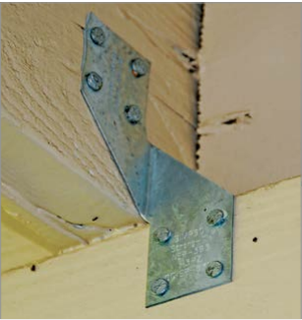
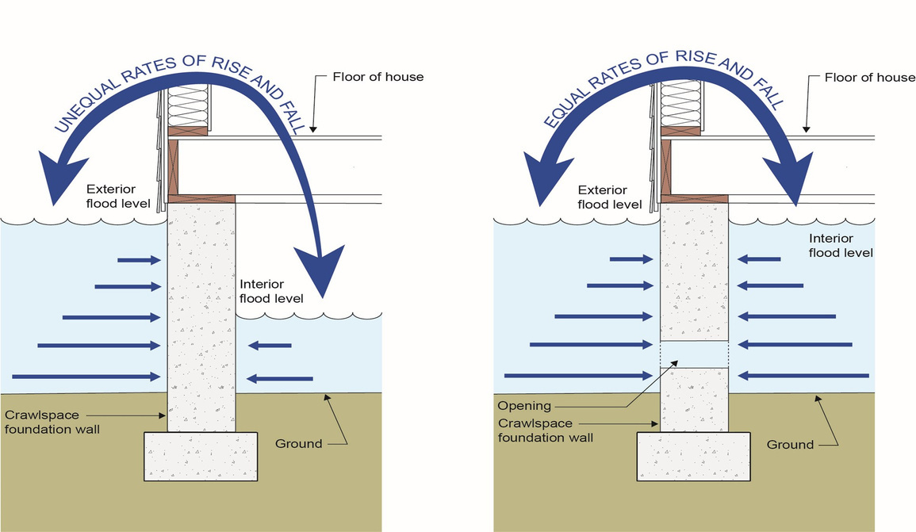
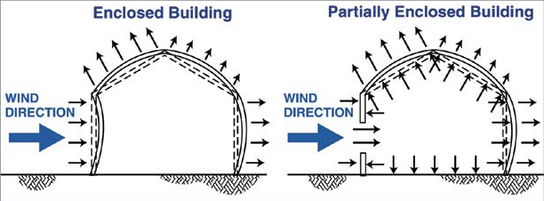
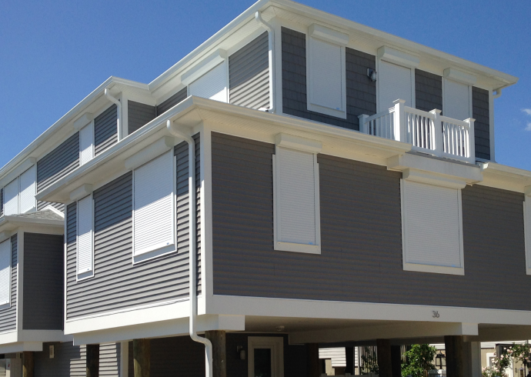
Credits: Dennis Hwang, Hawaii Sea Grant
Credits: Joseph W. Lstiburek, Ph.D., P.Eng., Fellow ASHRAE
Credits: FEMA’s Residential Coastal Construction Manual (2011)
Credits: Shade & Shield, 2023
Notes:
1- H3 clip, rafter/truss-to-top-plate connection, resists lateral and uplift loads
2- shows the pressure difference and benefits of installing a flood vent
3- intact vs not intact- pressure difference on the inside can lead to the roof flying off
4- roll-down shutters

Slide 25
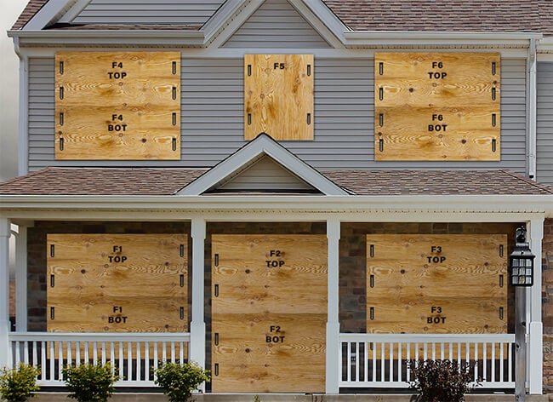
Secure your home immediately before a storm
    Unplug all unnecessary appliances
    Brace doors and windows
    Store fertilizers and other toxic chemicals above flood levels
    Secure propane tanks
    Fill gas tanks for cars and generators

Slide 26
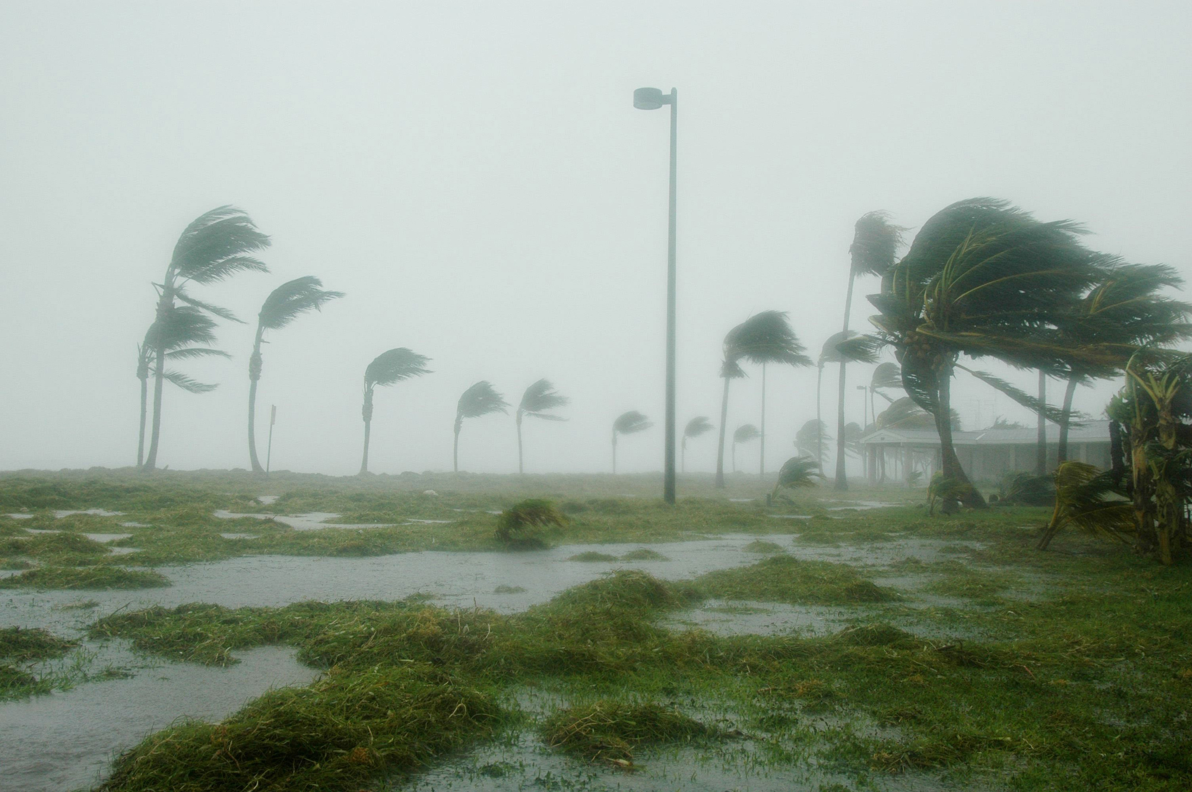
    DO NOT DRIVE OR WALK THROUGH FLOODWATERS
      As little as 6 inches of floodwater can damage your vehicle and knock a person off their feet
      Electrocution is a real danger from downed live wires
      Saltwater is extremely corrosive, especially for electric vehicles
    Stay off the roads unless driving is absolutely essential
Source: coast.noaa.gov
Notes:
1 foot of moving water can wash away a car

Slide 27
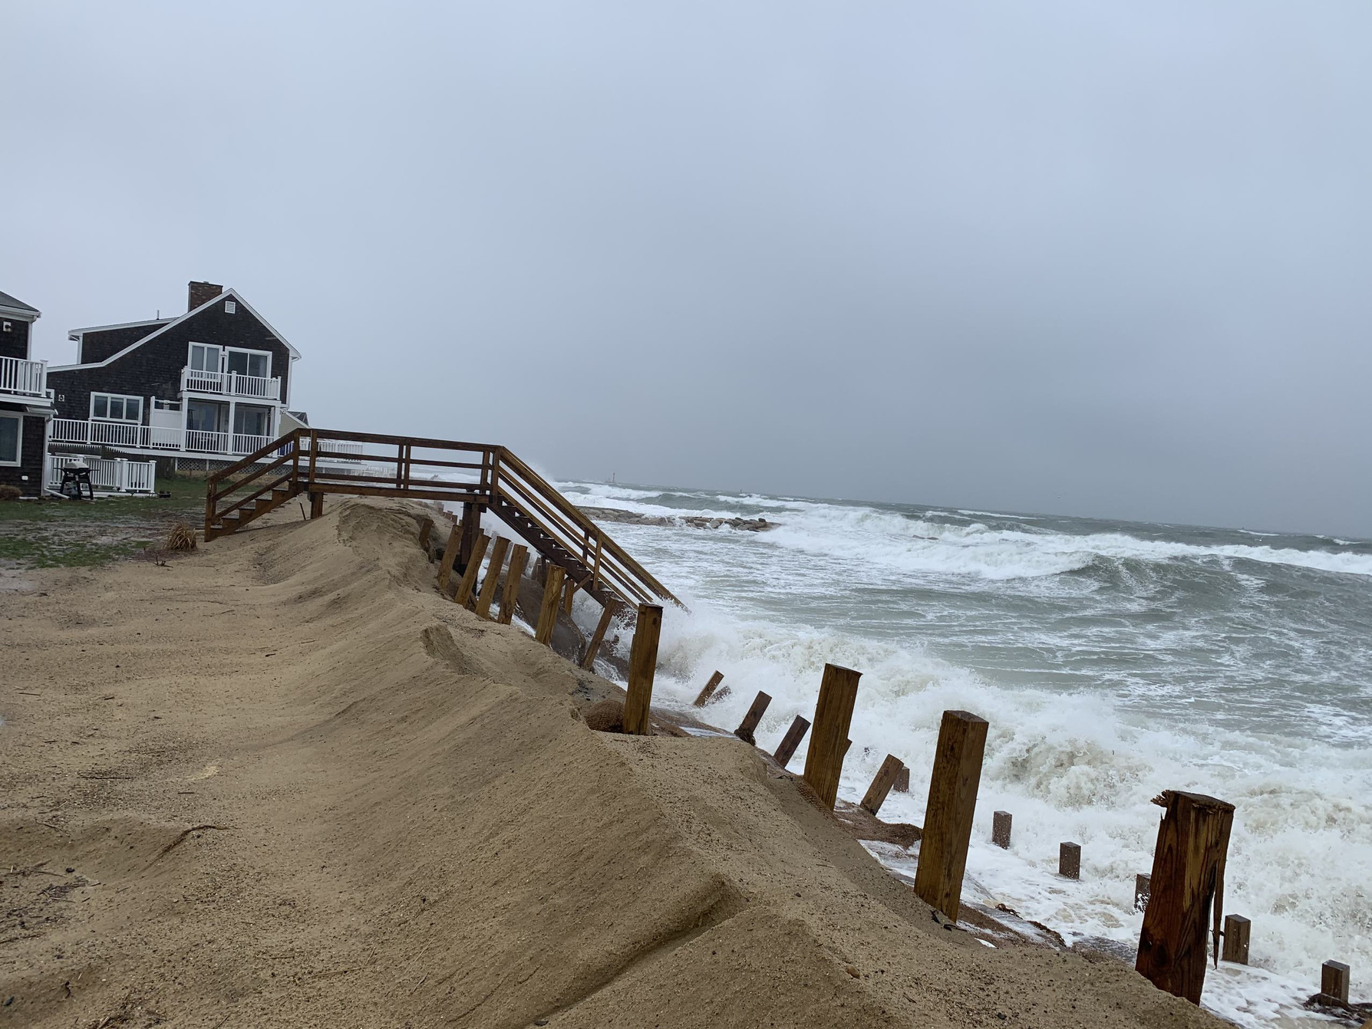
If you have any structural damage:
    File a flood insurance claim
    Get a permit before you do any work
    Properly dispose of any debris
    Review your town’s building code and other requirements
Notes:
Permit- applies within and outside of the floodplain
Other requirements include zoning, conservation, historical

Slide 28

https://images7.memedroid.com/images/UPLOADED817/59f73001ca474.jpeg

Slide 29
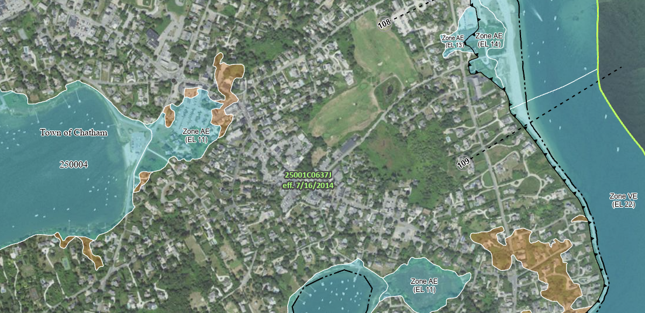
Living in the Floodplain
Know your FEMA flood zone!
About 75% of all presidentially-declared disasters involve flooding.
Notes:
even if you don't live in a floodplain, water doesn't follow the lines we draw on maps so especially if you're close, you should still consider yourself at risk from flooding and obtain flood insurance. About 25% of all flood claims come from outside the floodplain!
Document everything

Slide 30
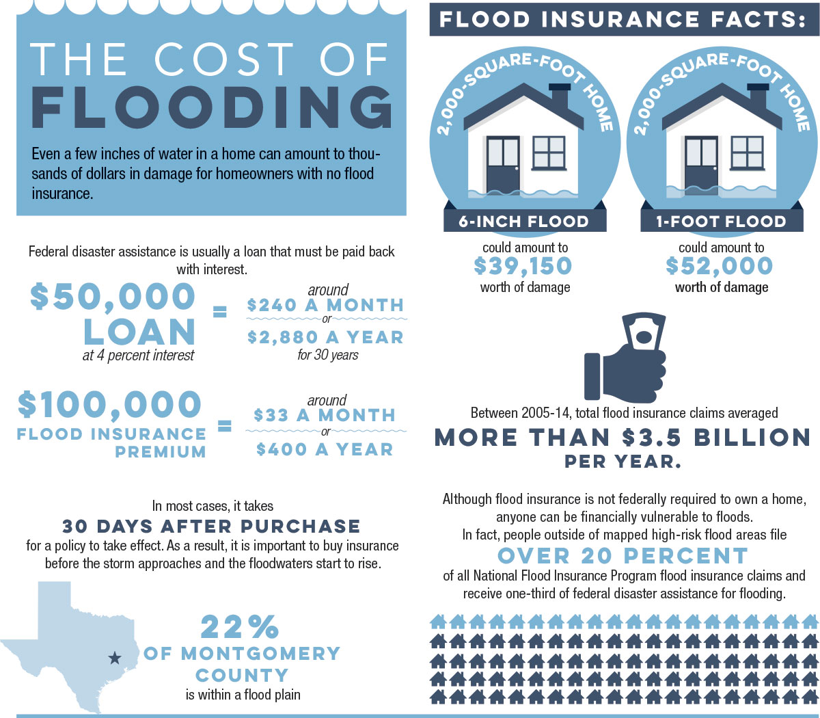

Slide 31
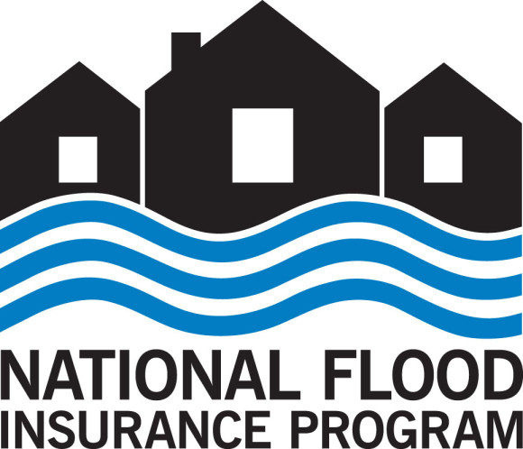
Flood Insurance
If you live in a FEMA floodplain and have a federally backed mortgage, then you must have a flood insurance policy. Most homeowners insurance policies do not cover flood damage.
    Private or through NFIP
    Is it mandatory?
    What's covered?
    Reach out to the town or county for more information
      Shannon Hulst, Floodplain and CRS Specialist: Shannon.Hulst@capecod.gov
Notes:
Flood insurance brochures

Slide 32
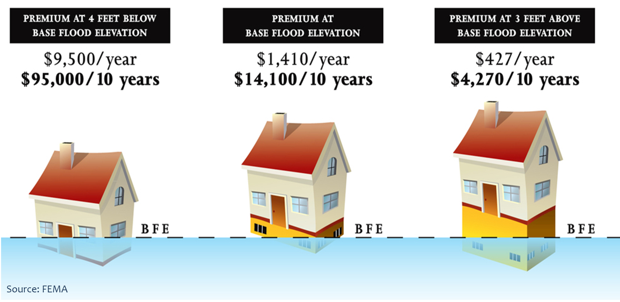
Notes:
Double check with your local agent on your exact flood insurance rates
Elevating machinery and equipment to the second floor or attic gets an 8% discount
Other factors include distance from source of flooding, type of foundation, first floor elevation, and average cost to build in the zip code

Slide 33
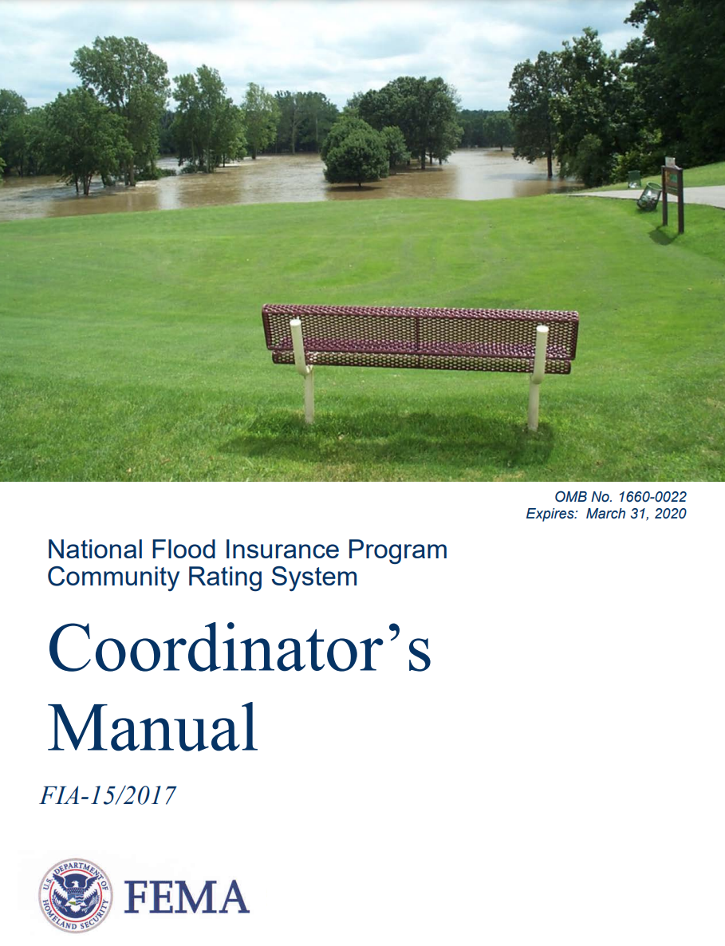
Community Rating System
Flood insurance discounts in exchange for actions that reduce flood risk
Improves flood resilience
  Incentive for resilience
  Improved building code enforcement & awareness
  Open space preservation
  Public education
  Ideas for advanced floodplain management
Notes:
The town acts, the homeowner benefits

Slide 34
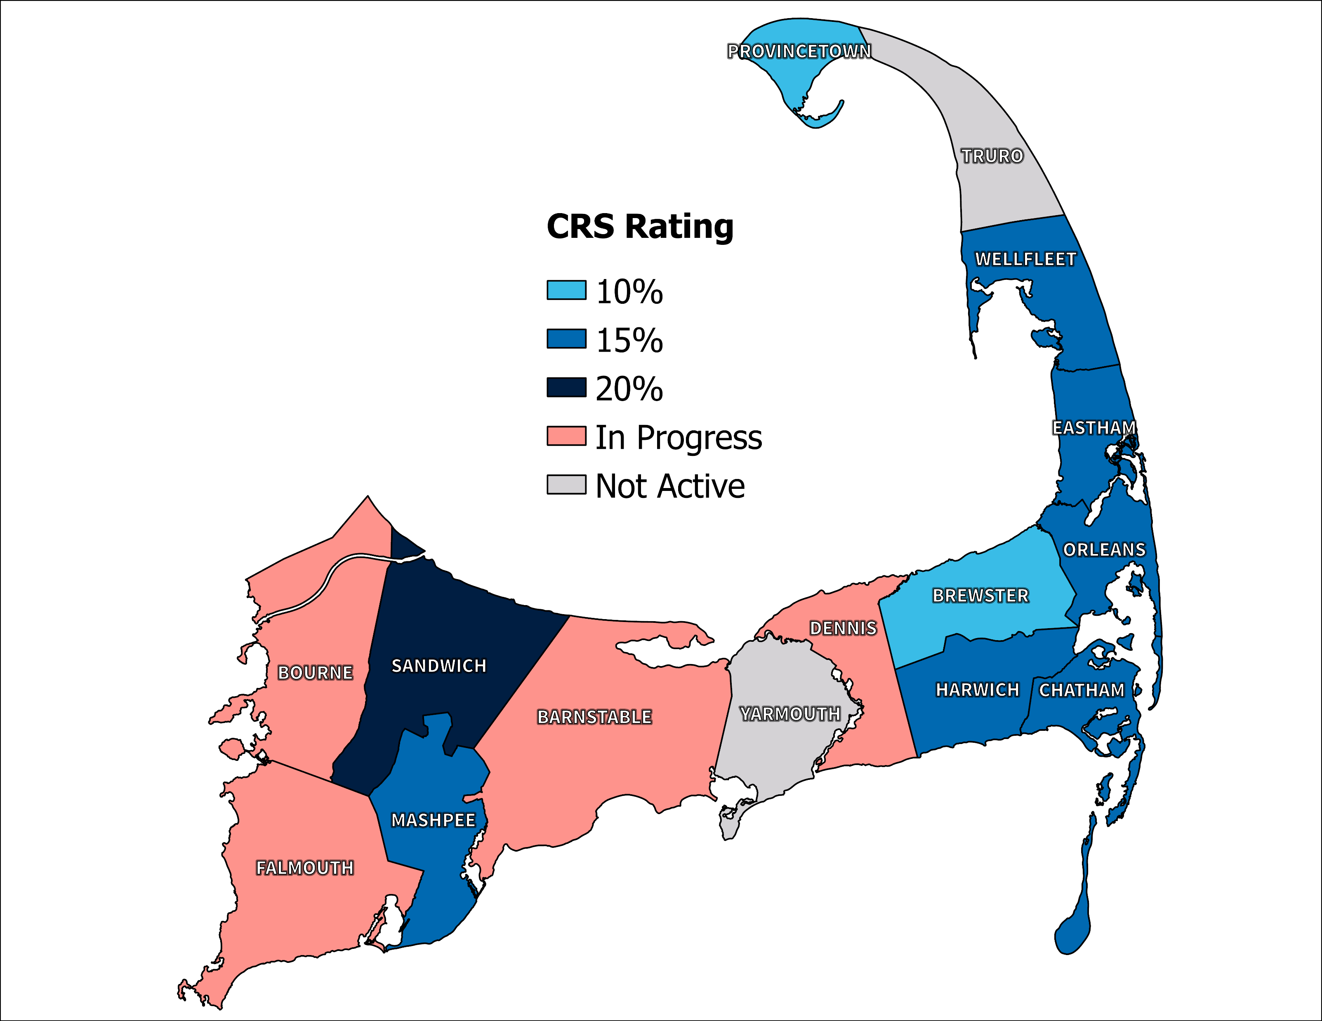
Notes:
$2.5 million in saving since creation

Slide 35
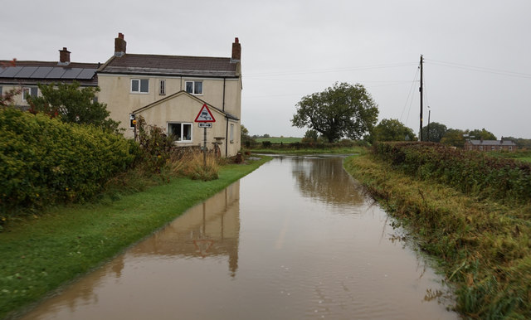
FUNDING SOURCES
  USDA Relief
    Requires a disaster declaration (2023 in Western MA)
    Low-interest loans
  Massachusetts Farm Resiliency Fund
    Created after 2023 flooding
  USDA Farm Service Agency Loan
This Photo by Unknown Author is licensed under CC BY-SA

Slide 36
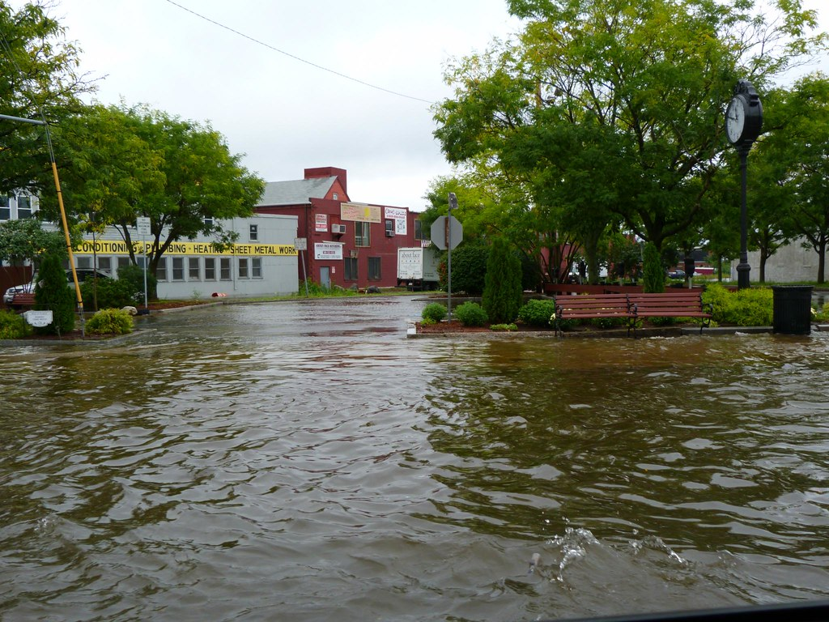
More Funding!
  Small Business Administration
    Loans for real estate, personal property, machinery and equipment, and inventory and business assets
  National Center for Appropriate Technology (NCAT)’s ATTRA (Appropriate Technology Transfer for Rural Areas) Program
    Provides technical assistance and climate solutions
This Photo by Unknown Author is licensed under CC BY

Slide 37

STRUCTURAL FUNDING SOURCES
  Hazard Mitigation Assistance Program
    Elevation, retrofitting, relocation, and demolition
  Housing and Urban Development 203(K) Loans
    Flood safety improvements
  NRCS Emergency Watershed Protection Buyout Program
    Must receive a federal disaster declaration
    Only in A zones
Credits: Sanghwan Kim via Canva Images

Slide 38
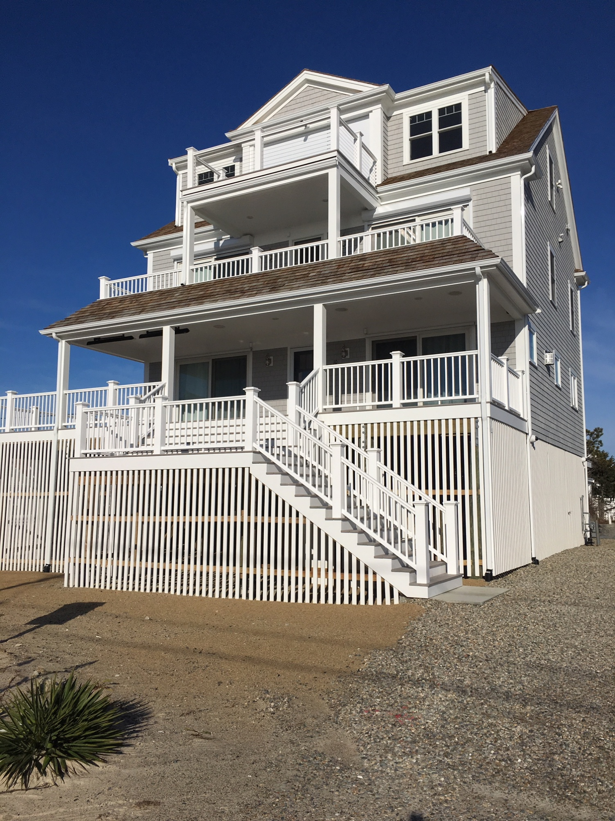
FLOOD MITIGATION ASSISTANCE GRANTS
  Provides federal dollars for individual mitigation projects
  Must apply through your town
  Lengthy application and reimbursement process
  25% cost share
  Must have a flood insurance policy through the National Flood Insurance Program
Notes:
Will decrease flood insurance annual premium
some homeowners insurance companies are more likely to continue insuring a structure that is to floodplain code than not

Slide 39

OTHER CONSIDERATIONS
  Design Guidelines
    Flood Area Design Guidelines | Cape Cod Commission
  Bylaws and regulations
    Enforce new building code
    Higher resilience regulations for wetlands
    file (capecodcommission.org)
Notes:
Design guidelines- special considerations for historical structures
Model coastal resilience bylaw
Newburyport’s climate resilience plan

Slide 40
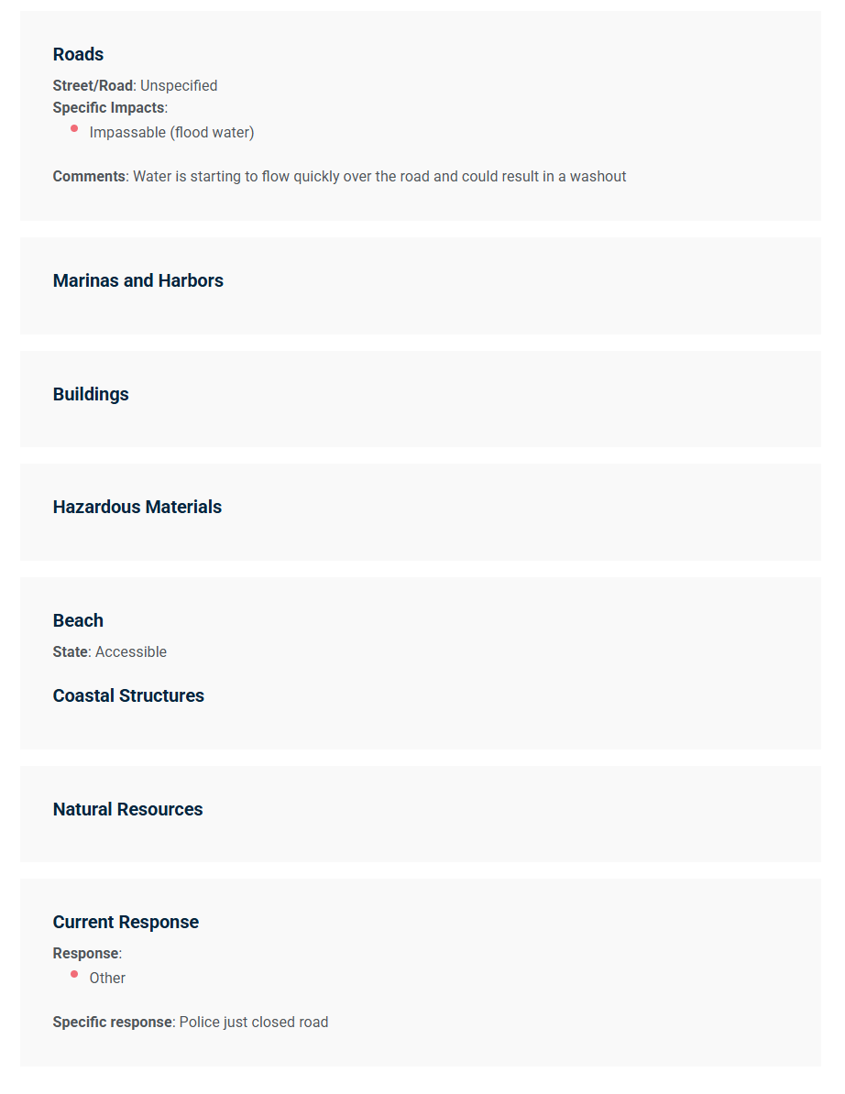
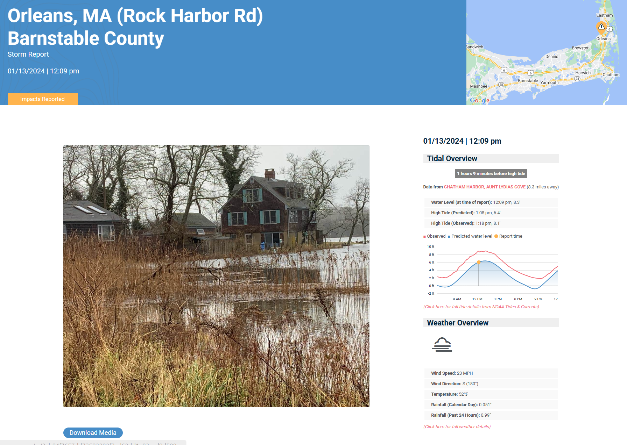
Calls to Action
MyCoast
Advocate for stricter bylaws and regulations
Be prepared! Have a plan!
Take care of yourself
https://mycoast.org/reports/149849
Notes:
Be a community ambassador

Slide 41
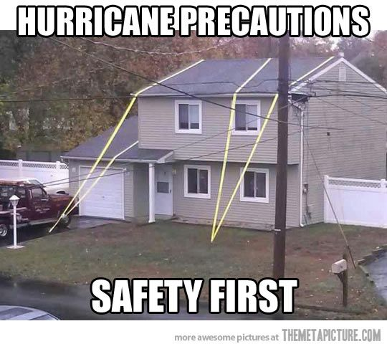
So... Are you ready?

Slide 42

Thank you!
Any Questions?
Shelly McComb
shelly.mccomb@capecod.gov

